Slide 1


GATE AUTOMATION AND HELMET DETECTION
Under the supervision of
Mr. Saket Jha
Group Member:
Ashish Kumar Senapati (160731072030)
Jitu Nayak (160731072047)
Lalit Kumar Mahabhoi (160731072050)

Slide 2
Contents:
1. Introduction and Overview
2. Problem Statement
3. Objective
4. Hardware/Software Requirements
5. Working Model
6. Project Flow Diagram
7.Application
8.Conclusion
9.Referenece

Slide 3
1.Introduction and Overview
What is IoT?
The Internet of things (IoT) is the network of devices such as vehicles, and home appliances that contain electronics, software, sensors, actuators, and connectivity which allows these things to connect, interact and exchange data.

Slide 4
2.Problem Statement
In Traditional Gate System , the gate is controlled manually as well as the record is pen and paper which is difficult to manage.
The guards have to check if the two wheeler person comes with or without helmet and take suitable actions accordingly.

Slide 5
3.Objective of our project
An RFID Based Smart Gate Automation System that regulates the vehicles in various organizations.
We are checking tag ID with our database every time a new vehicle arrives and allow access to the registered employee vehicles.
This uses image processing with tensorflow to check whether the person is wearing a helmet or not.

Slide 6
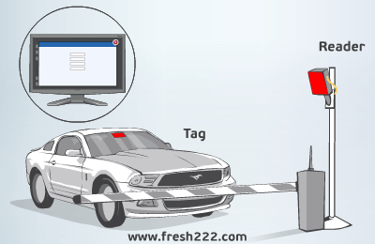

Slide 7
Hardware Requirement
Arduino
Raspberry Pi3
Camera Module
Buzzer
PC Monitor
RFID Active and Passive Tag
Servo Motor

Slide 8
Software Requirements
Arduino IDE
Python 3
Tensorflow
MQTT
Electron JS
Windows 10/Linux
MySQL

Slide 9
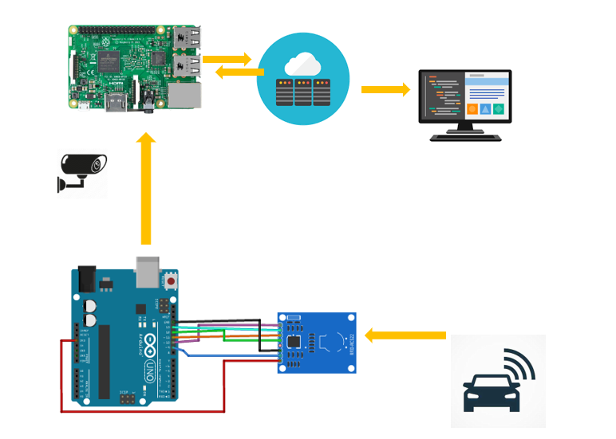
Project Flow Diagram

Slide 10
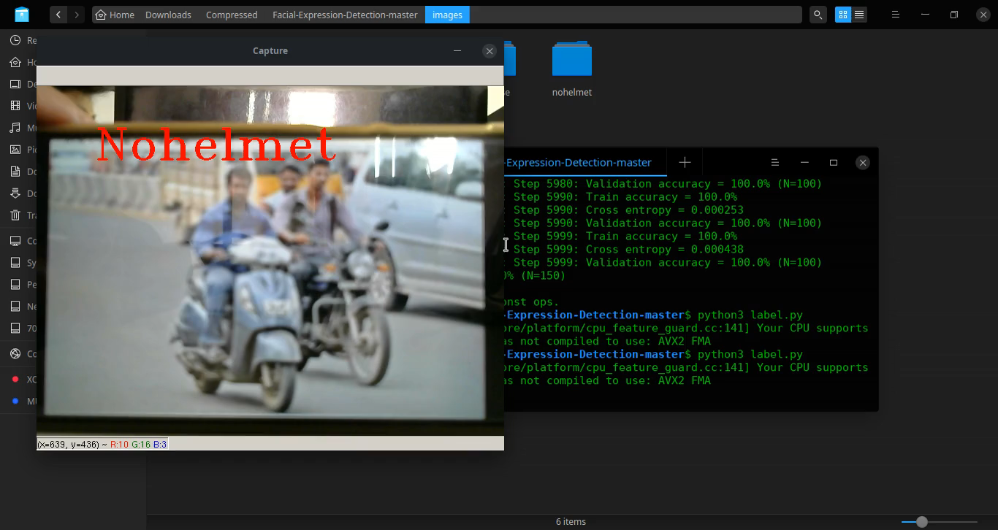

Slide 11
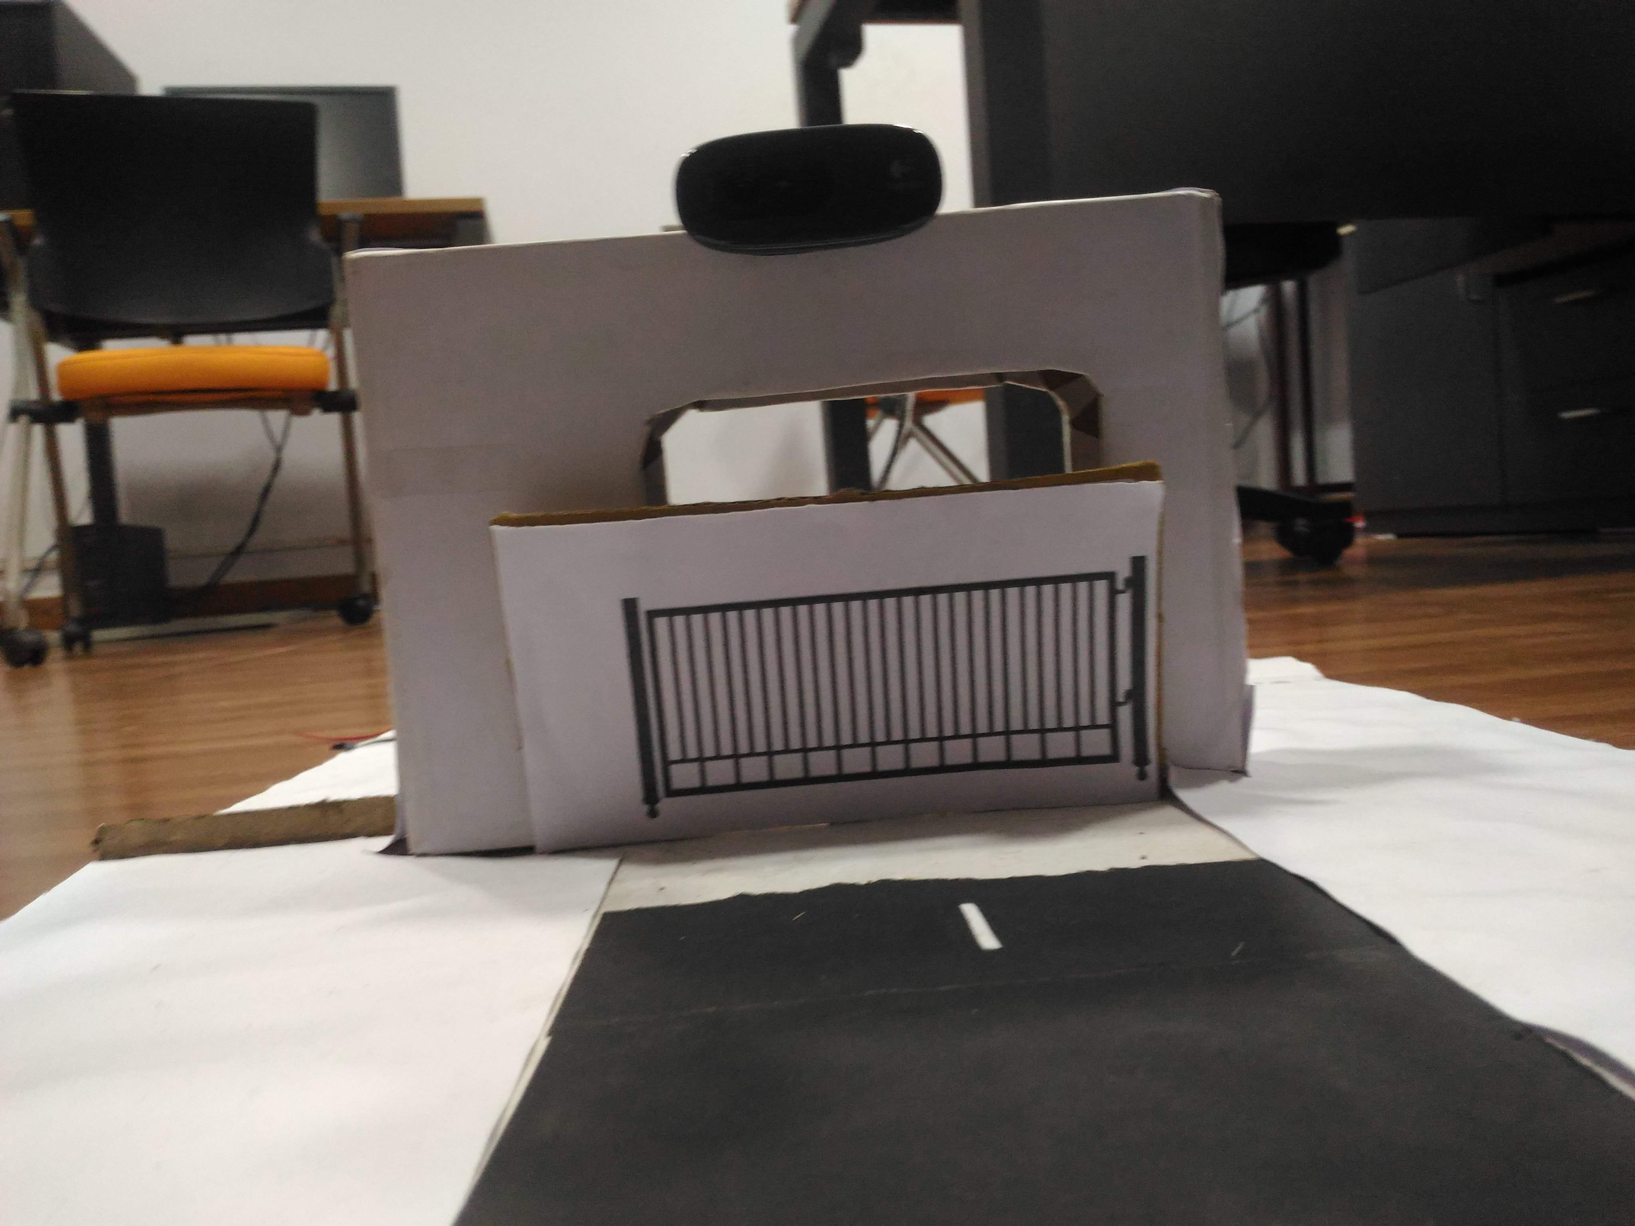

Slide 12
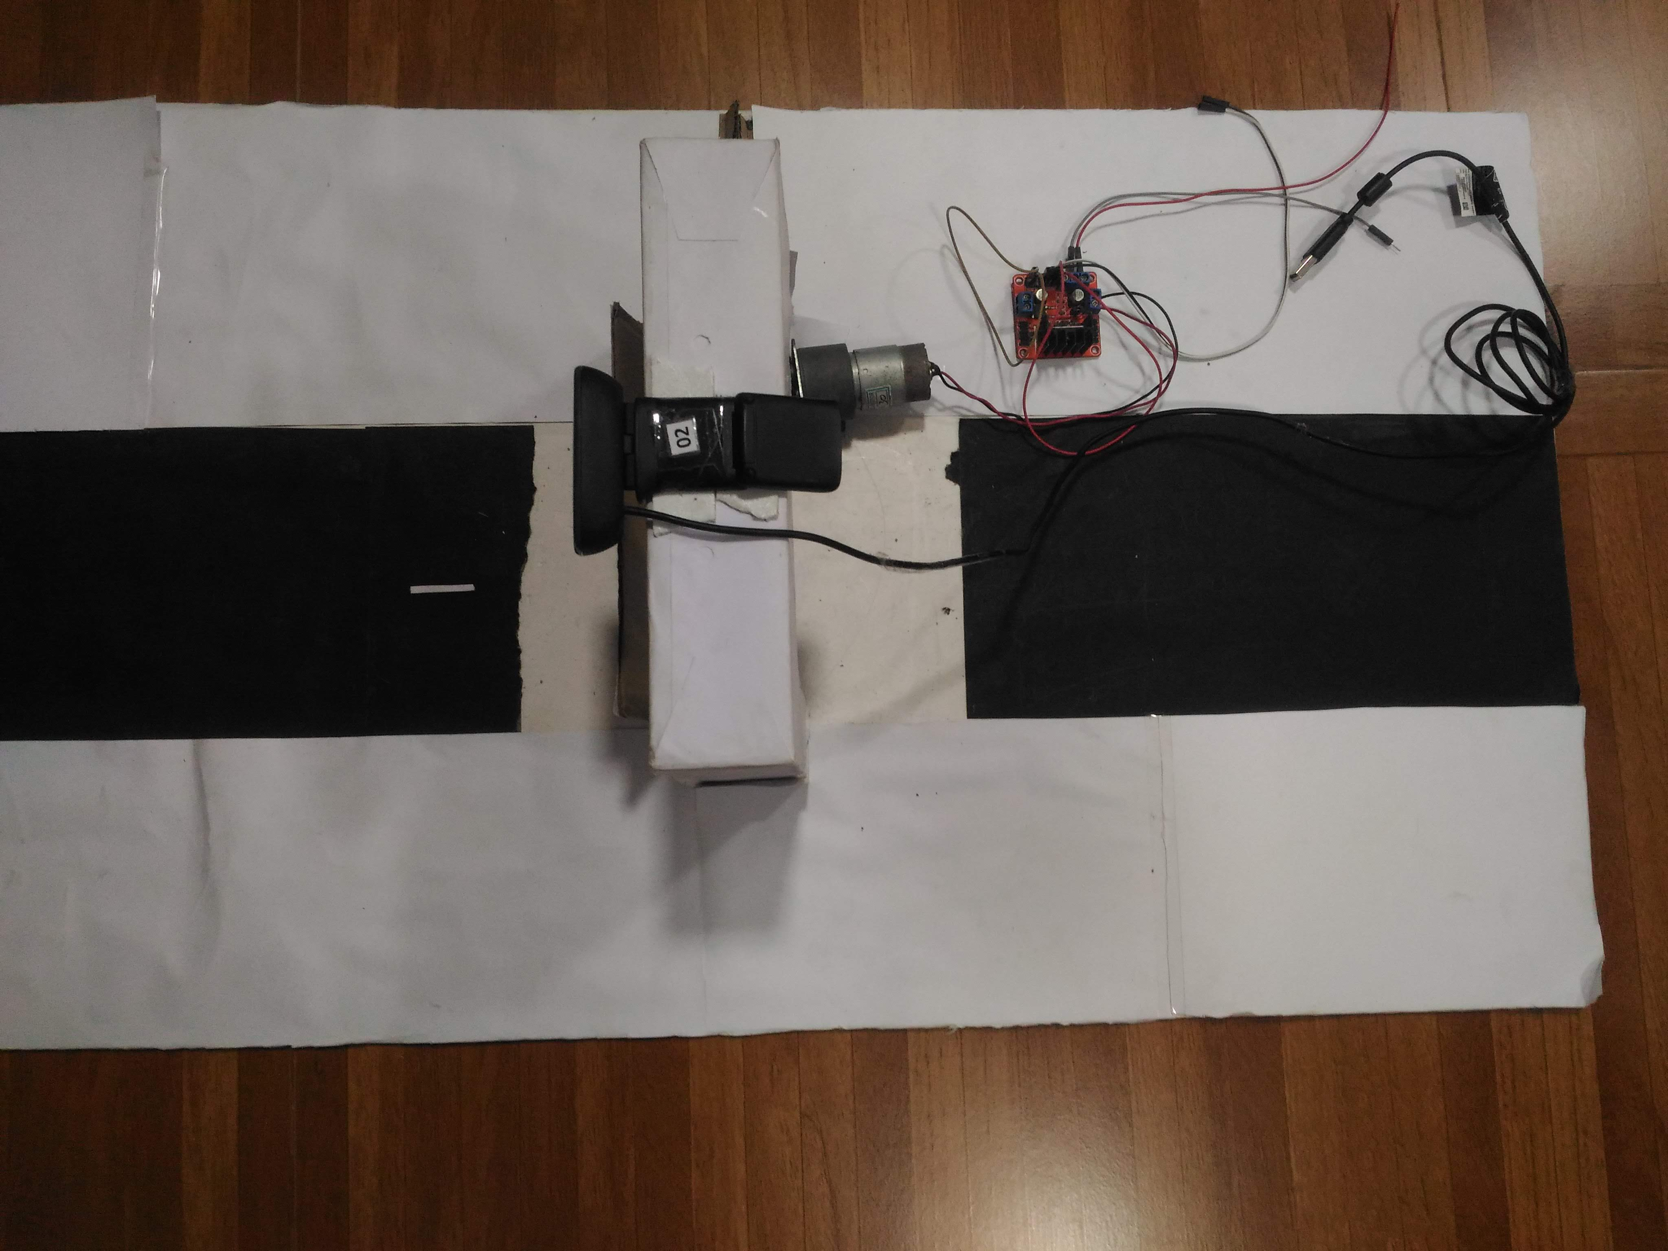

Slide 13
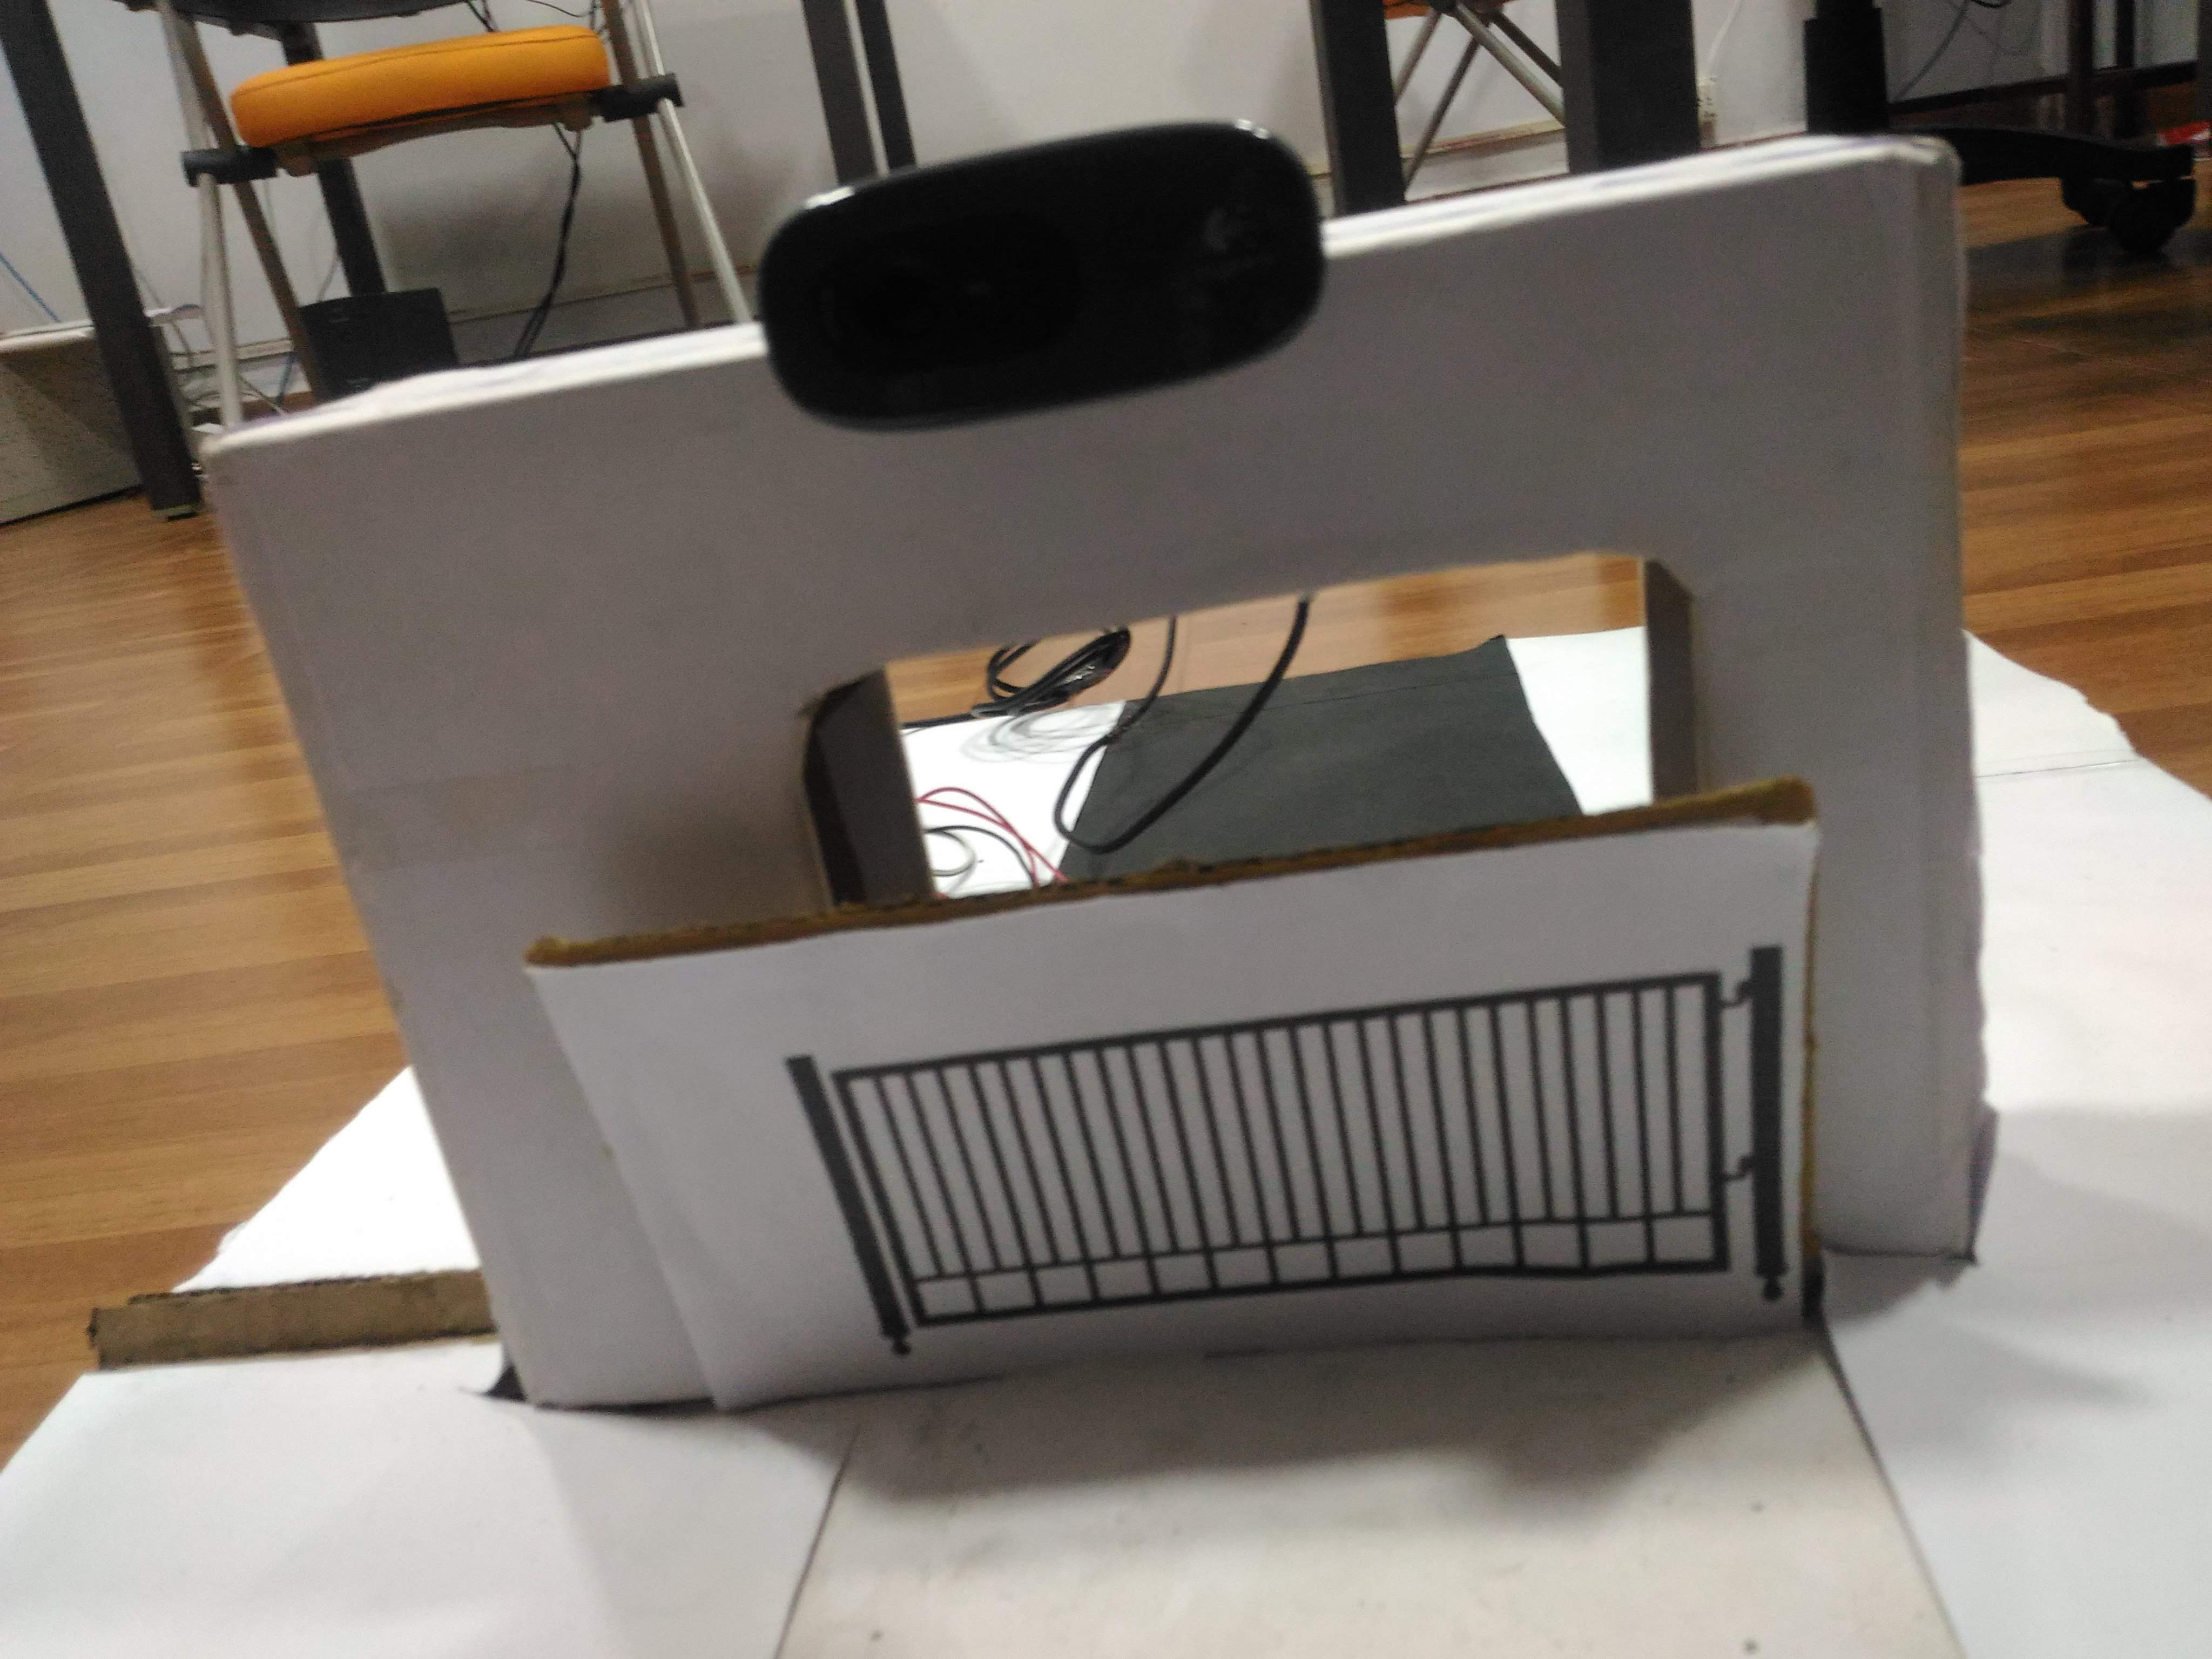

Slide 14
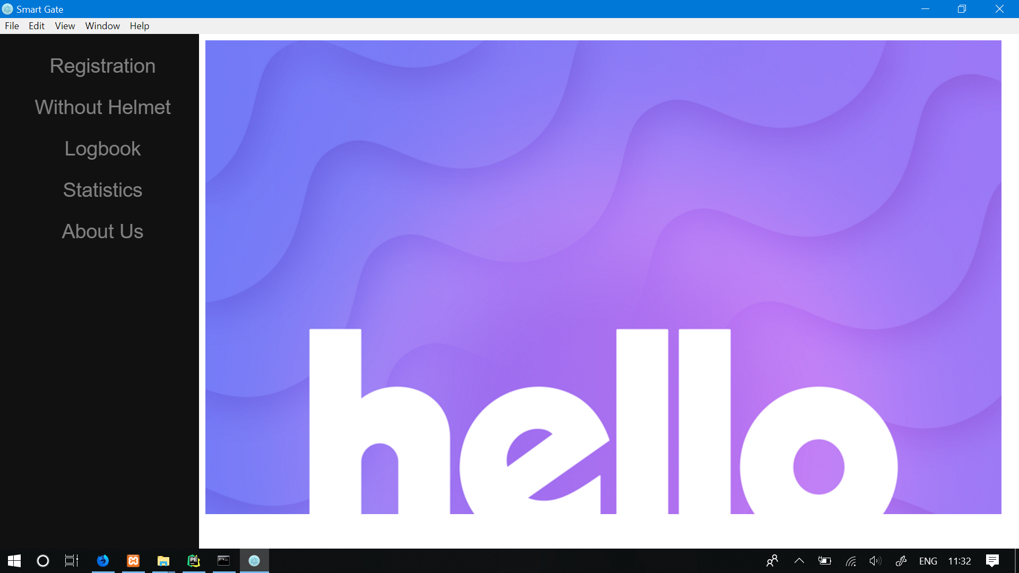

Slide 15
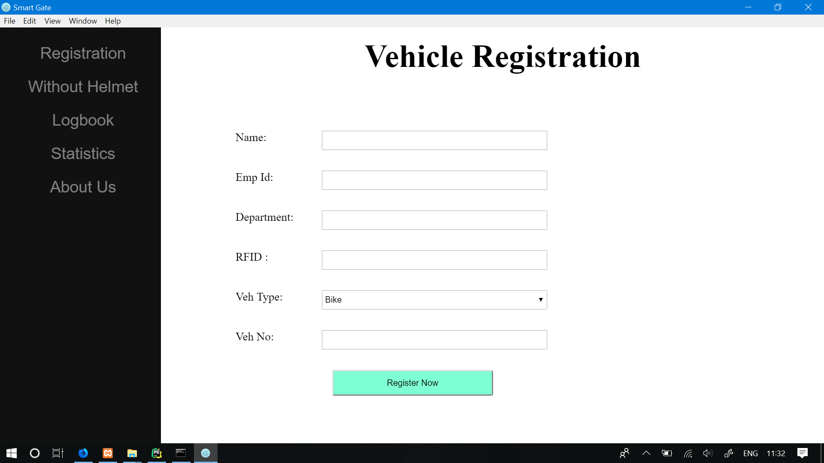

Slide 16
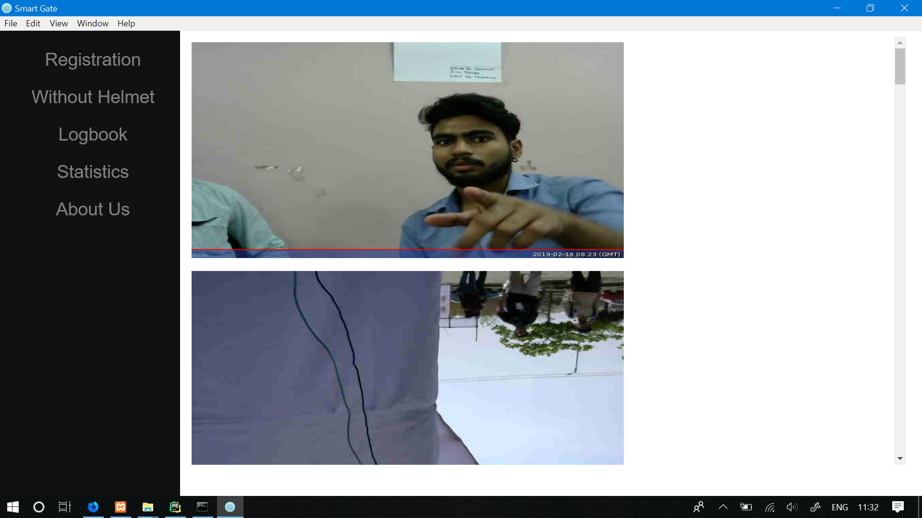

Slide 17
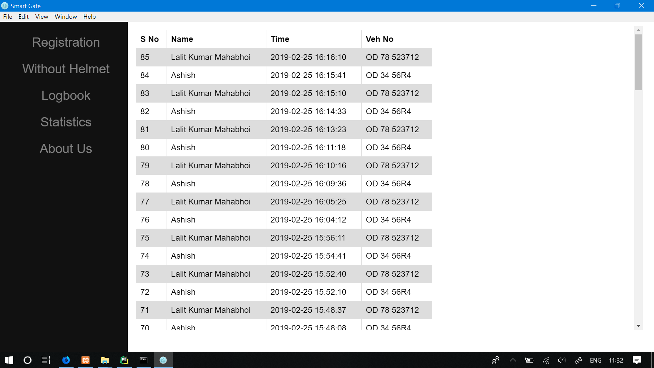

Slide 18
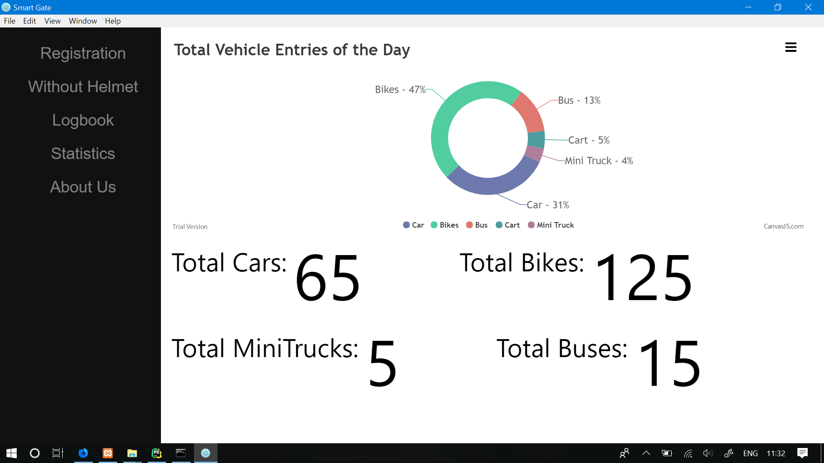

Slide 19
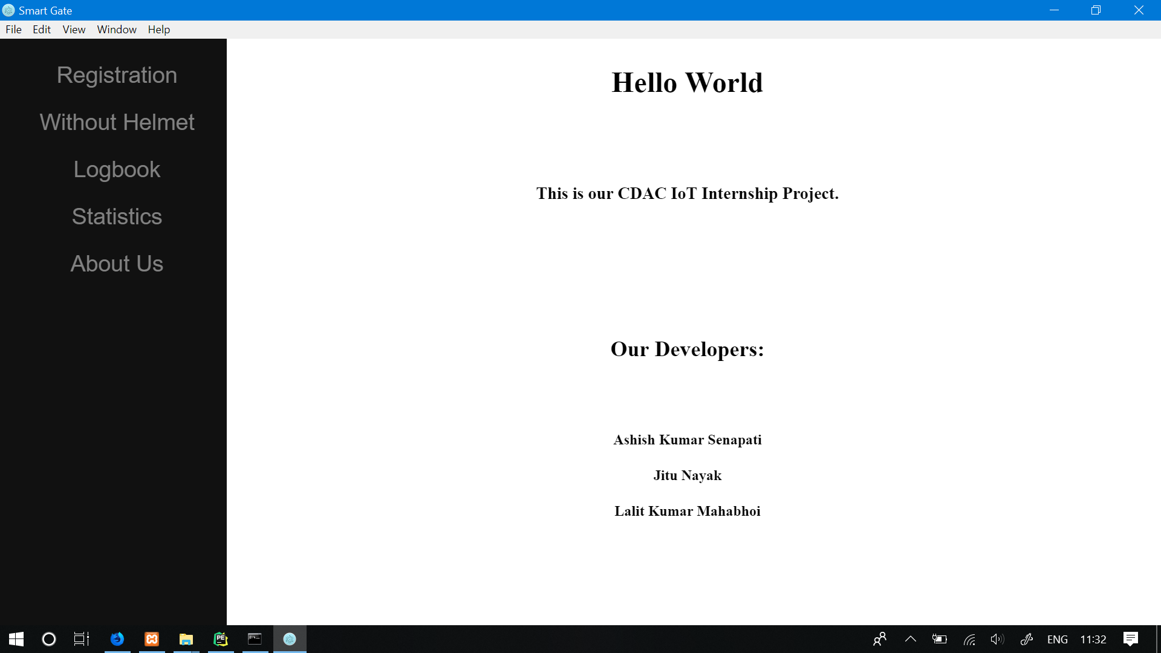

Slide 20
Application
It can be deployed in any organization’s entry points
Hospitals
Apartments
Helmet detection can be deployed in traffic squares.

Slide 21
Conclusion
By using this IoT device in Traditional gate we can automate everything by Using Machine Learning for automation to make the process swift and efficient for work.
It also provides security and maintain record of Daily entry data of an organization.

Slide 22
Referenece
https://howtomechatronics.com/tutorials/arduino/arduino-dc-motor-control-tutorial-l298n-pwm-h-bridge/
https://www.w3schools.com/python/python_mysql_getstarted.asp
https://randomnerdtutorials.com/security-access-using-mfrc522-rfid-reader-with-arduino/

